Slide 1
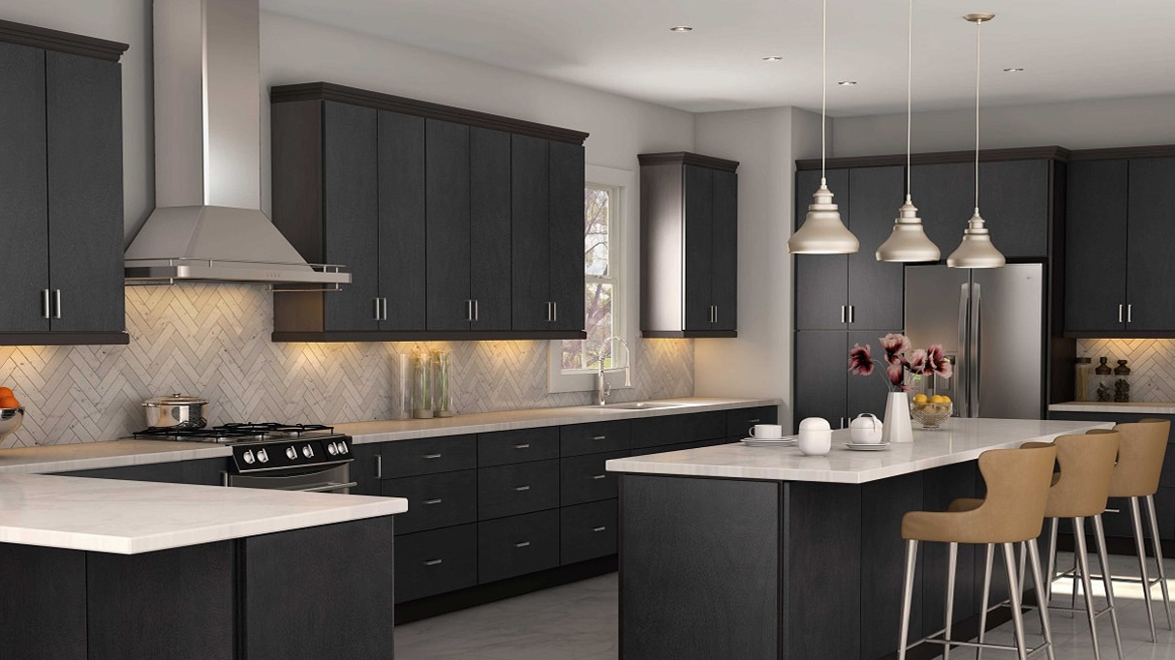
OCR Processing
To Implement Smart Kitchen
2019707047 권동욱
2017707062 유태영
2017707043 이종근

Slide 2

A table of Contents
01
Project Abstract
02
Reason for Selection
03
Related Ability
04
Project Plan

Slide 3
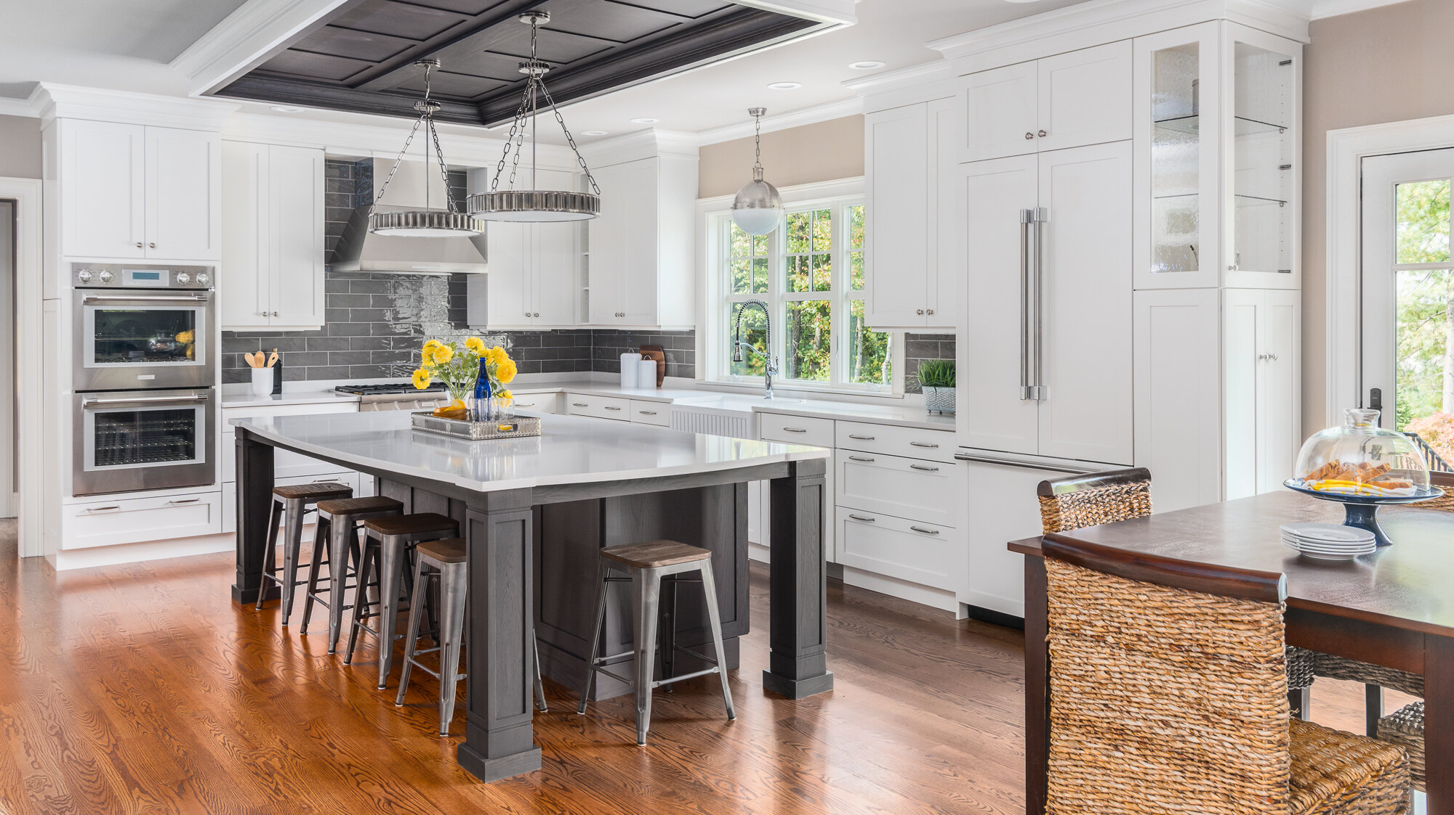
01. Project Abstract

Slide 4
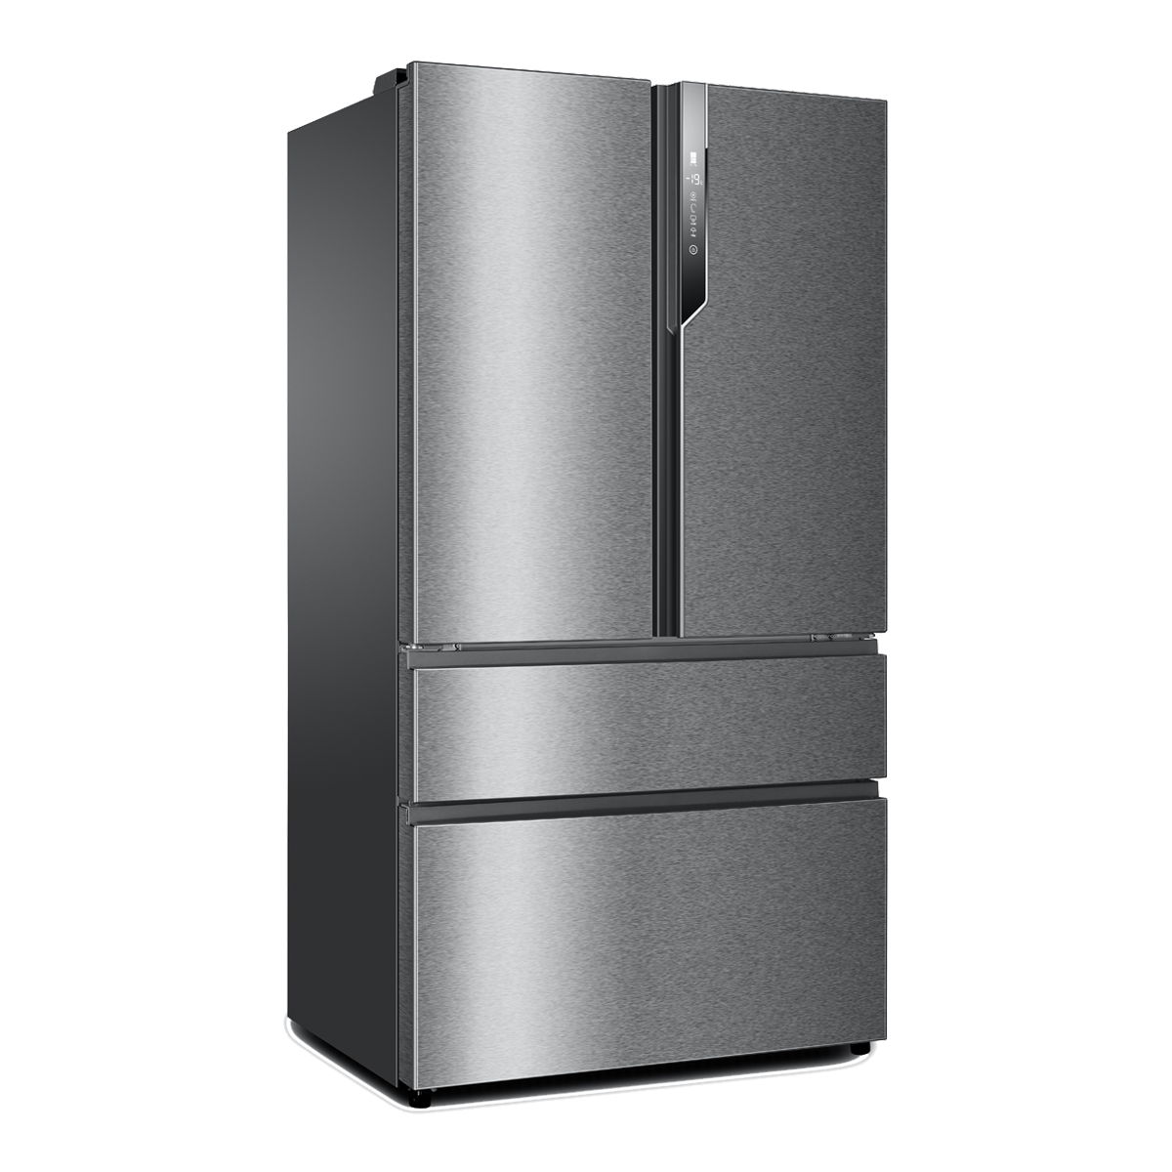
01. Project Abstract
Using OCR to take images
Food Recognition with camera
Saving and Listing data
Collecting and analyzing
Processing literal character and images
Recommend Recipes based on Data

Slide 5
01. Project Abstract
Using OCR to take images
Food Recognition with camera
Saving and Listing data
Collecting and analyzing
Processing literal character and images
Recommend Recipes based on Data

Slide 6
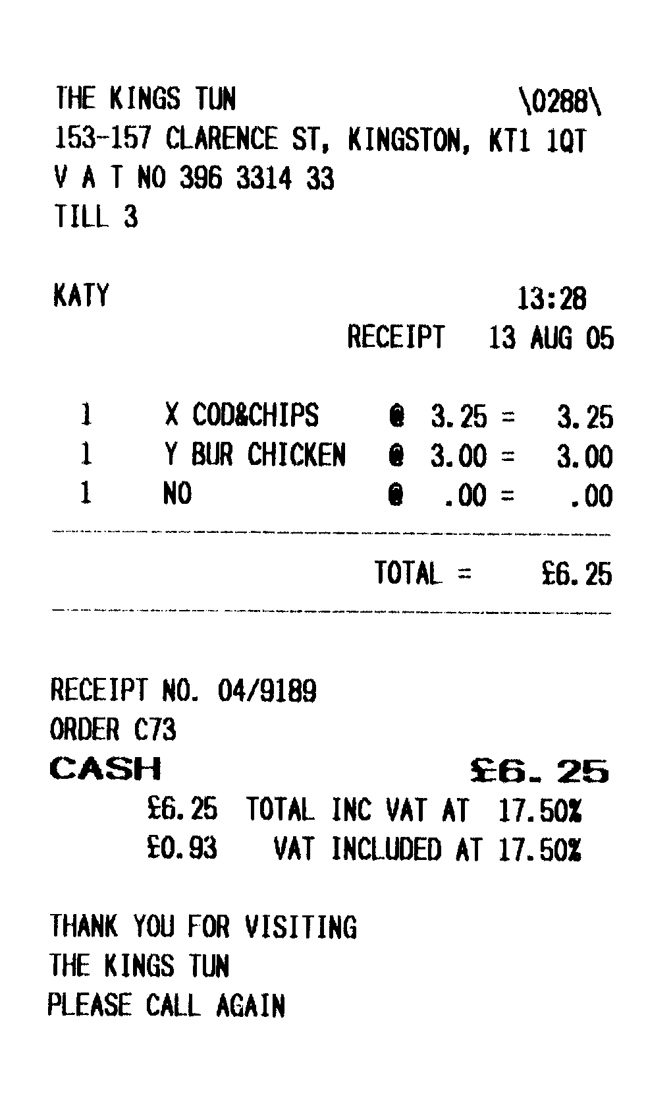
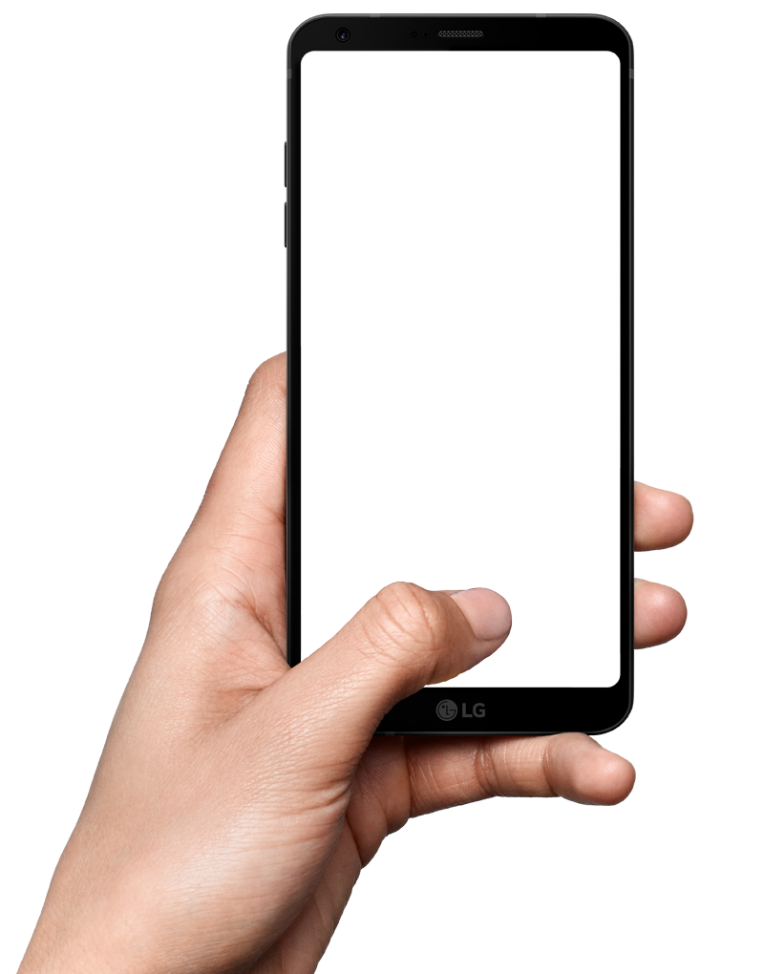
01. Project Abstract
Scanning Receipt
Listing Data

Slide 7
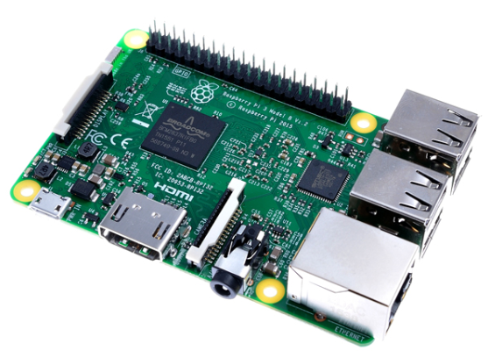
03. Related Ability
Combination & Listing Data
Collect Image Data
Collect Image Data

Slide 8
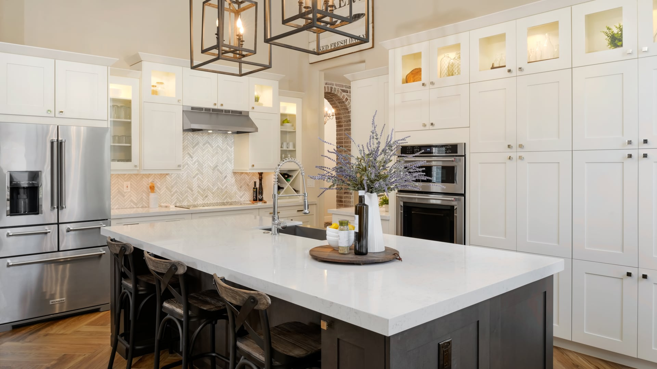
02. Reason for Selection

Slide 9
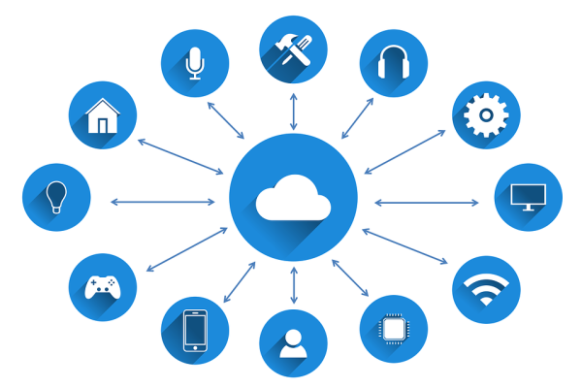
02. Reason for Selection

Slide 10
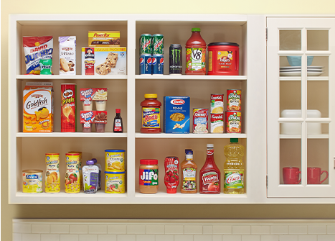
02. Reason for Selection
DATA

Slide 11
02. Reason for Selection
DATA

Slide 12
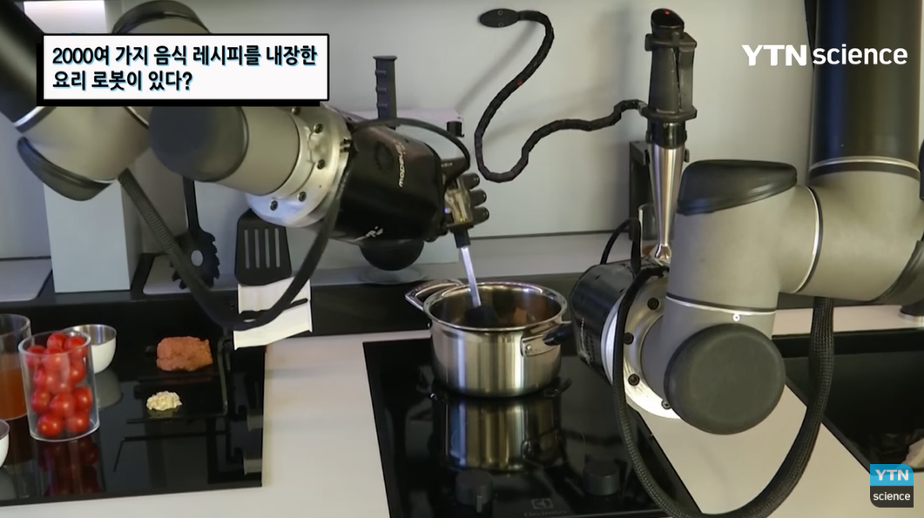
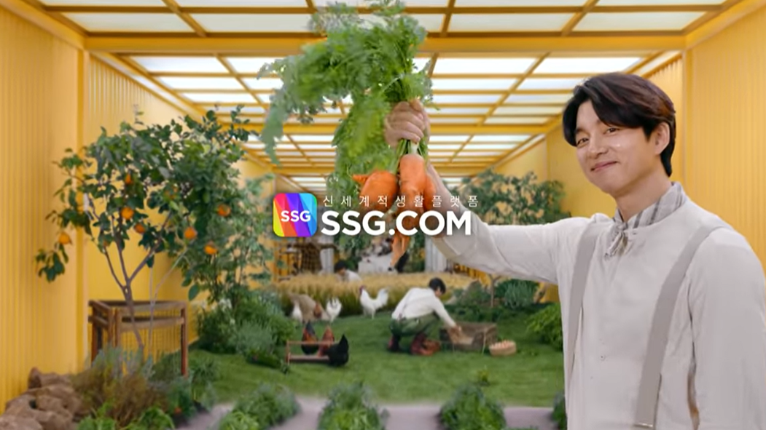
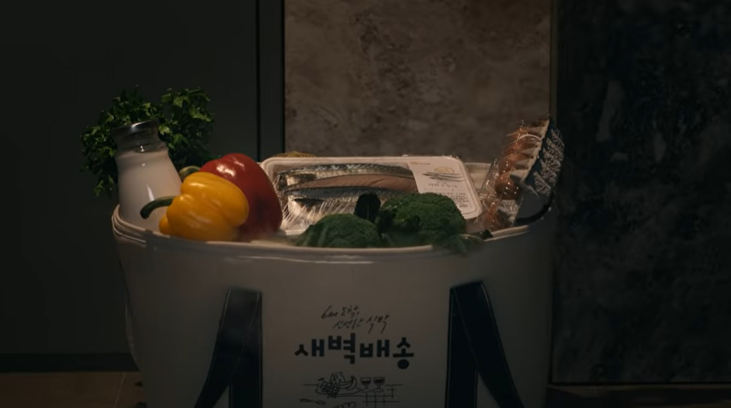

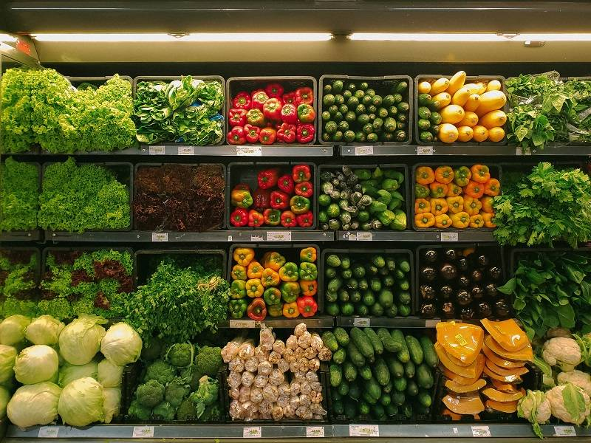
02. Reason for Selection
DATA

Slide 13
03. Related Ability

Slide 14
03. Related Ability
Computer Vision
Embedded
System
IoT
Big Data

Slide 15


03. Related Ability
Computer Vision
Design and Implementation of OCR program
Implementation in Python language

Slide 16
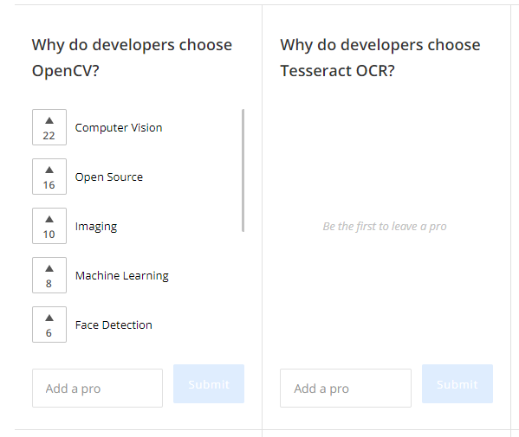
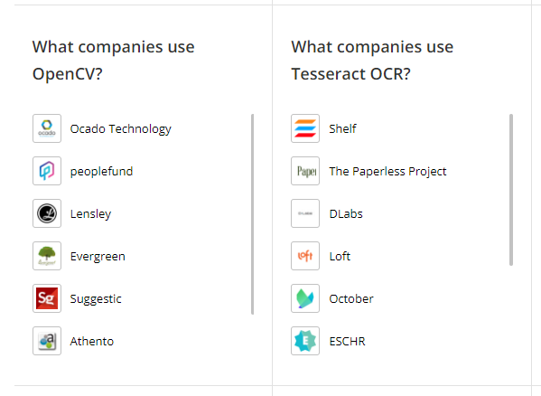
03. Related Ability
Computer Vision
Design and Implementation of OCR program
Using OpenCV & Tessaract OCR libraries
Compare OpenCV & Tessaract OCR libraries
source: OpenCV vs Tesseract OCR: What are the differences?/stackshare

Slide 17

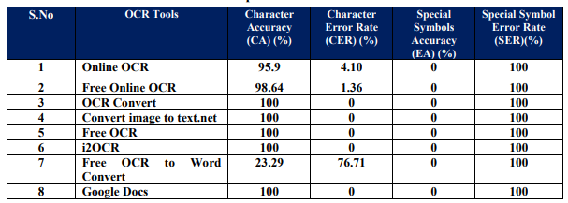
03. Related Ability
Computer Vision
Design and Implementation of OCR program
Comparison of existing open source algorithms
Scholar source: PERFORMANCE COMPARISON OF OCR TOOLS/Dr. S.Vijayarani1 and Ms. A.Sakila2

Slide 18
03. Related Ability
Embedded System
Design with Raspberry Pi and camera module
Experiment to see if the program works on Raspberry Pi

Slide 19
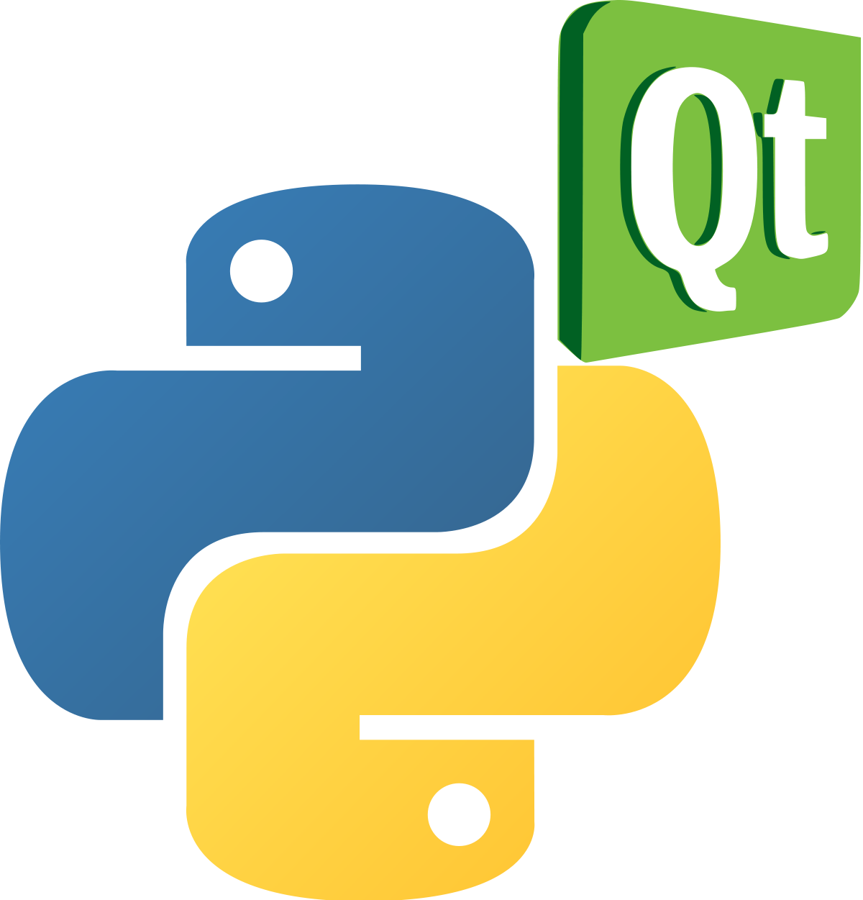
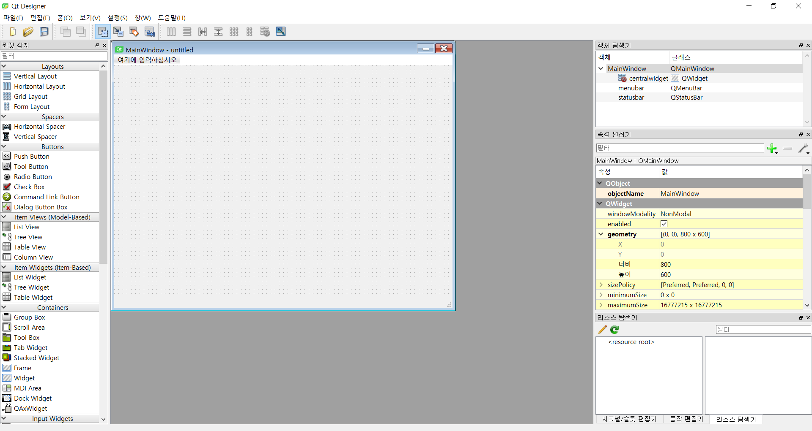
03. Related Ability
Embedded System
Design with Raspberry Pi and display module
GUI implementation with PyQt
Output the data to the display monitor

Slide 20
03. Related Ability
IoT
Communication between devices
Receive data from 2 or more Raspberry Pi

Slide 21
03. Related Ability
Big data
Listing accepted data after combining with existing data
DATA

Slide 22
04. Project Plan

Slide 23
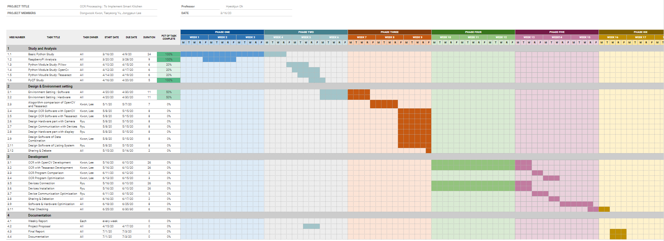
04. Project Plan

Slide 24
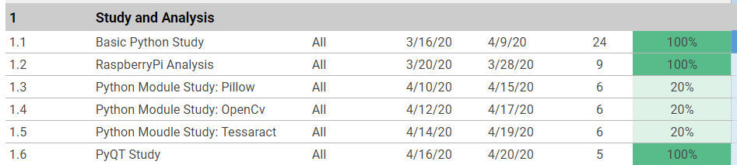
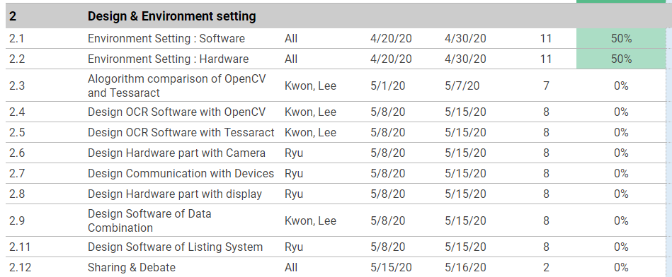
04. Project Plan

Slide 25
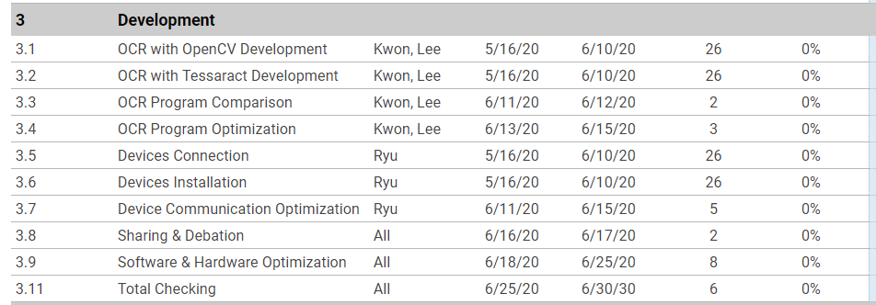
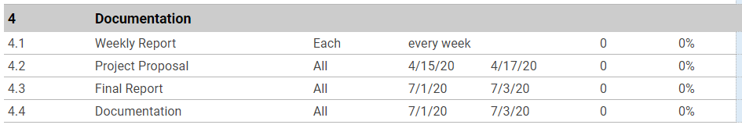
04. Project Plan

Slide 26
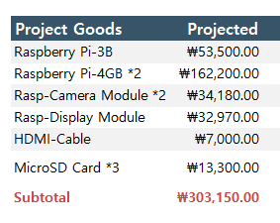
04. Project Plan

Slide 27
Image Source
Kitchen Picture-(p1, p3, p7, p12, p21) : The RTA Store, Kitchen Associates, Cabinet Solution,
A closer look at kitchen design trends for 2020/Washingtonpost
IoT Picture-(p8) : 기술 간 융합 촉진하는 IoT, 산업현장에 적용할 때 고려할 사항/e4ds news
Robot Arm-(p11) : 다양한 음식 레시피가 내장된 요리 로봇이 있다? / YTN 사이언스
Online Shopping-(p11) : ssg.com
Fresh Grocery-(p11) : Fresh Legend/Equal Oceon
Python Logo : python
Raspbian Logo : raspbian
Anaconda Logo : anaconda
PyQt Logo : wikipedia
Raspberry Pi Picture : raspberrypi

